Slide 1
Kolmogorov–Arnold Networks
中国科学技术大学 数据科学（数学） 许笑颜

Slide 2
Chapter 1 Author’s answers
来自05-24日腾讯会议记录

Slide 3
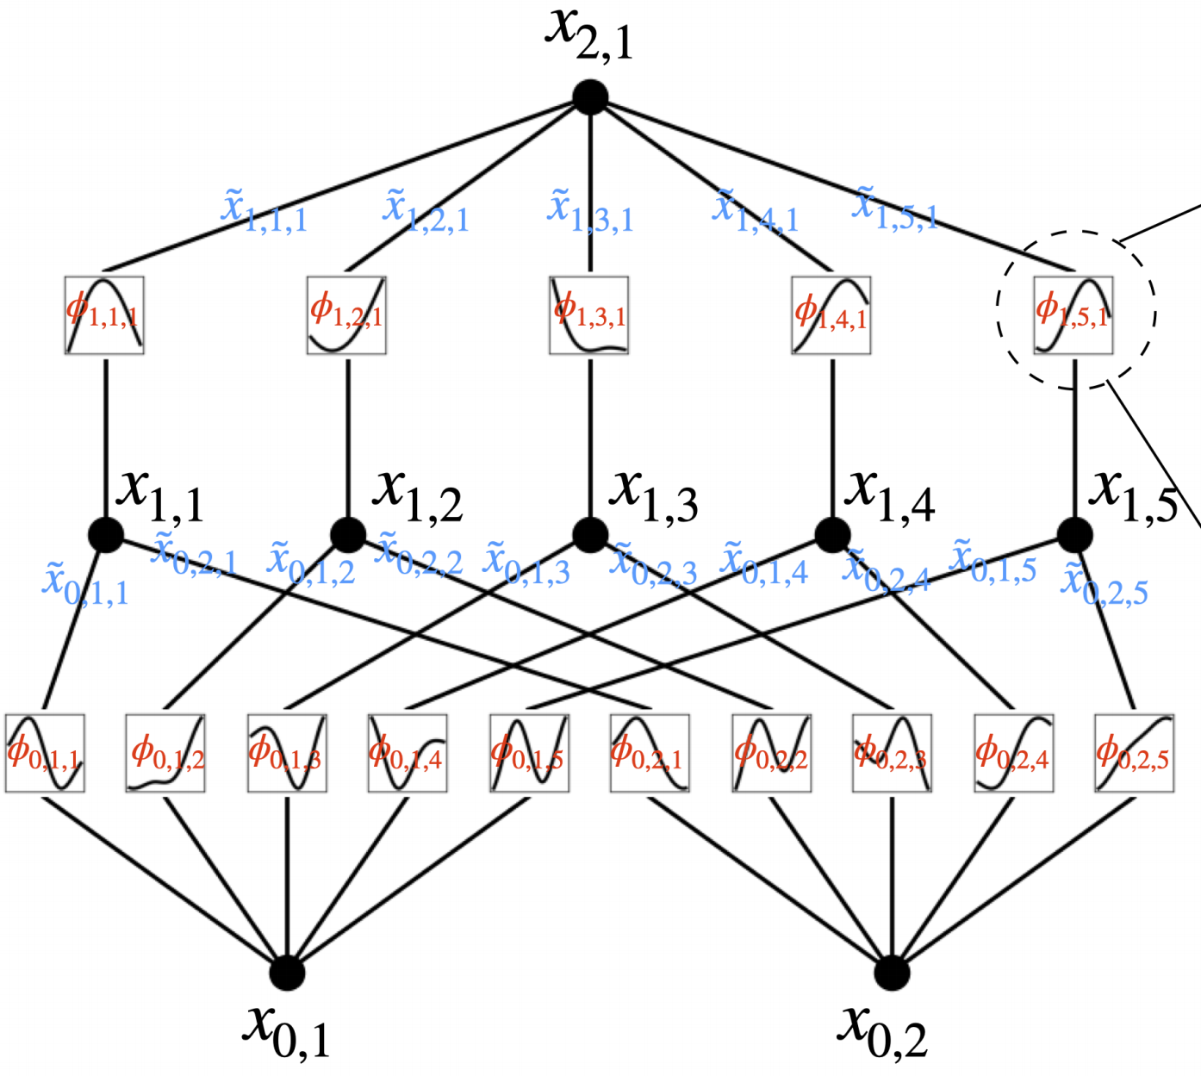
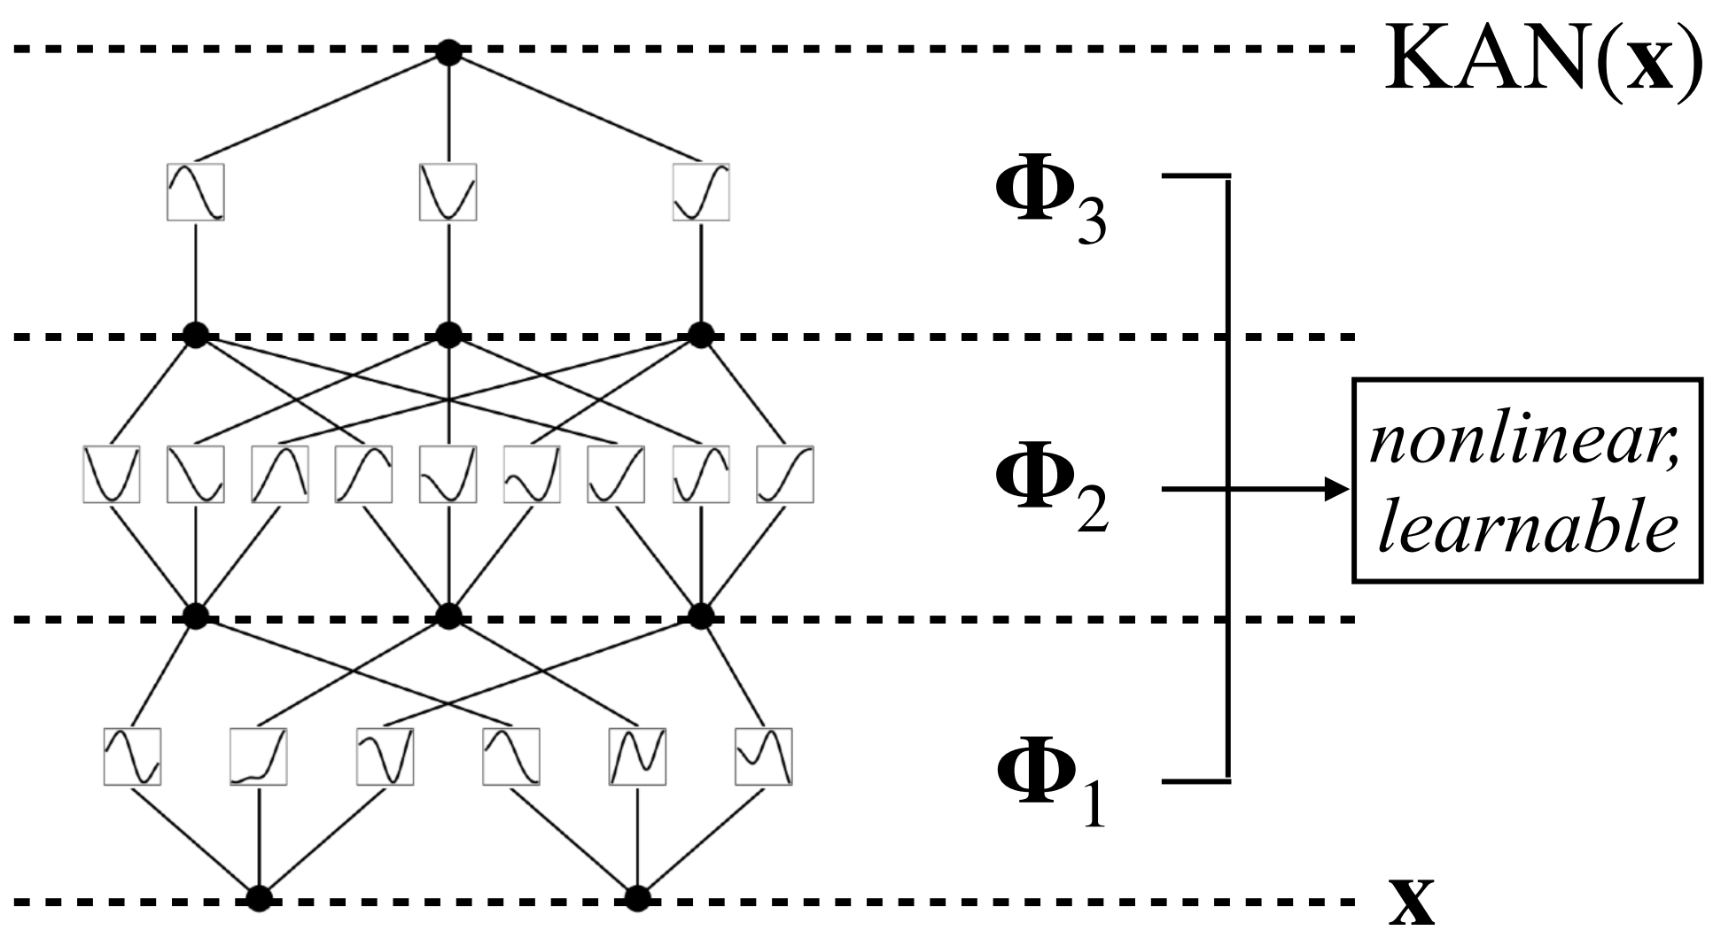
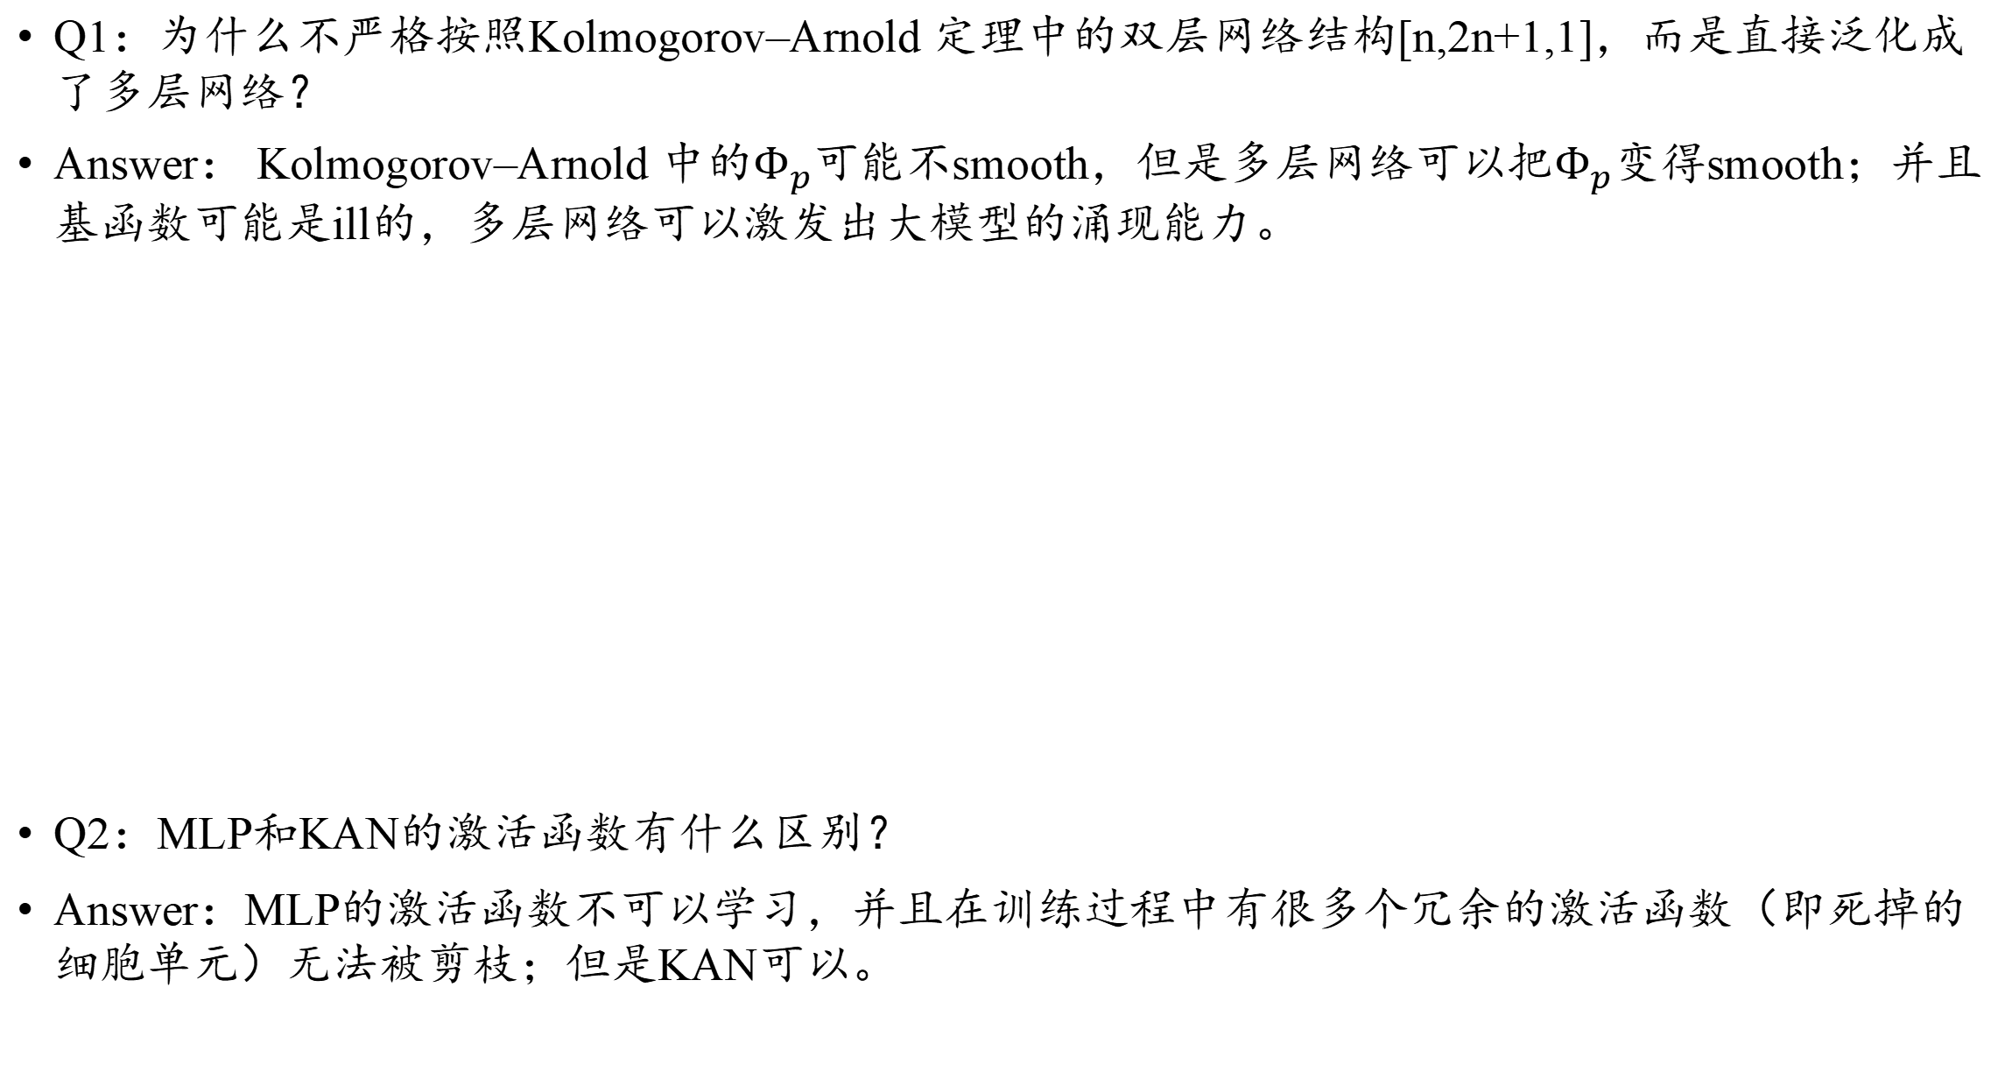
Kolmogorov–Arnold Networks作者回应
Q1：为什么不严格按照Kolmogorov–Arnold 定理中的双层网络结构[n,2n+1,1]，而是直接泛化成了多层网络？
Answer： Kolmogorov–Arnold 中的$Φ_{p}$可能不smooth，但是多层网络可以把$Φ_{p}变得$smooth；并且基函数可能是ill的，多层网络可以激发出大模型的涌现能力。
Q2：MLP和KAN的激活函数有什么区别？
Answer：MLP的激活函数不可以学习，并且在训练过程中有很多个冗余的激活函数（即死掉的细胞单元）无法被剪枝；但是KAN可以。

Slide 4
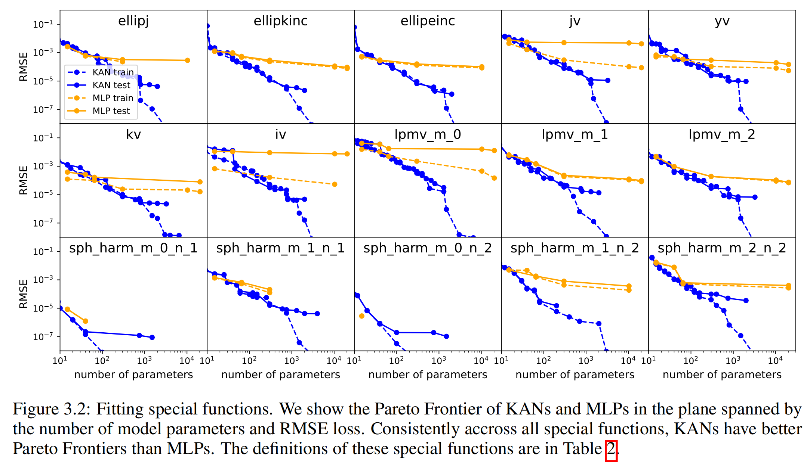
Kolmogorov–Arnold Networks作者回应
Q3: Figure 3.2图的网络结构是怎样的？
对于MLP：fixed width=[5,100], depth=[2,3,4,5,6]
对于KAN：fixed width=[5], depth=[2,3,4,5,6]

Slide 5
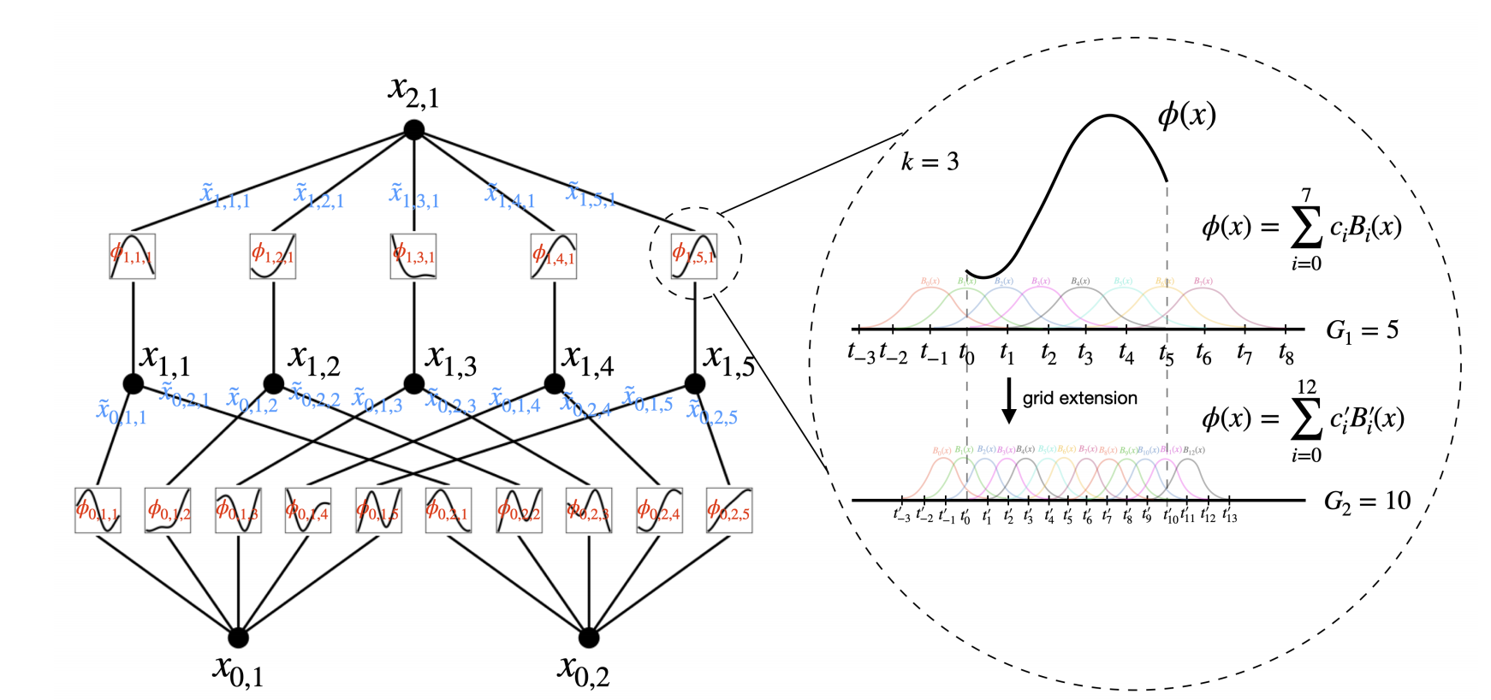
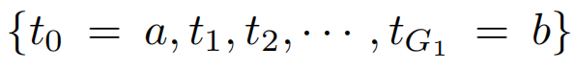
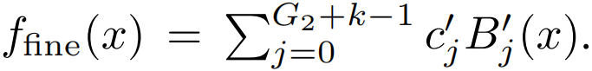
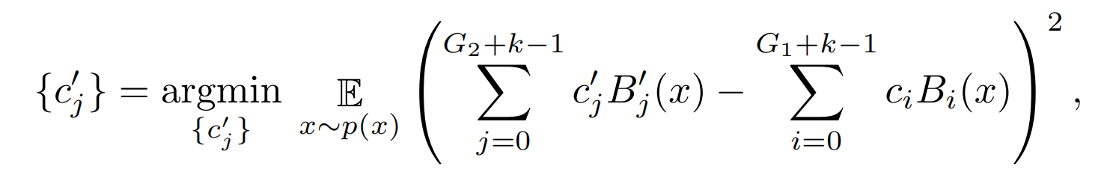
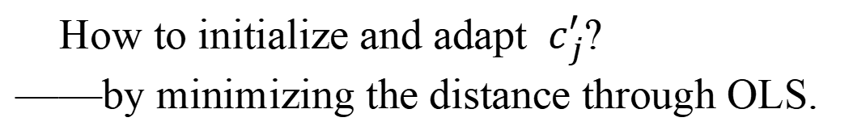
Kolmogorov–Arnold Networks作者回应
Q4: PINN作者公开质疑KAN方法在lid-driven cavity flow方程的收敛性表现？
Answer: 作者认为PINN团队并未正确使用KAN论文里的调参方法（比如引入网格更新与网格扩展（grid extension），先训练少量网格后再逐步加入数量更多的网格）。
How to initialize and adapt $c_{j}^{′}$?
——by minimizing the distance through OLS.

Slide 6
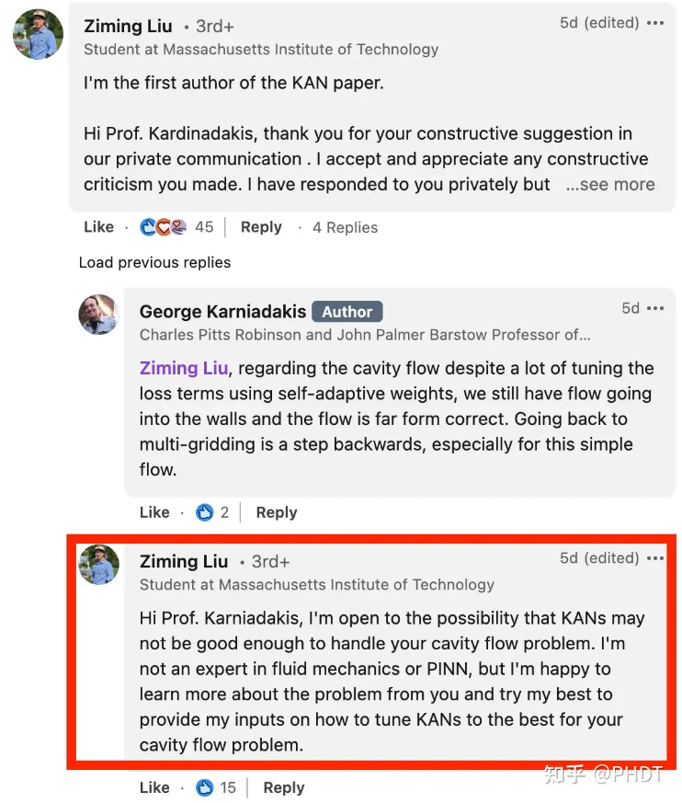
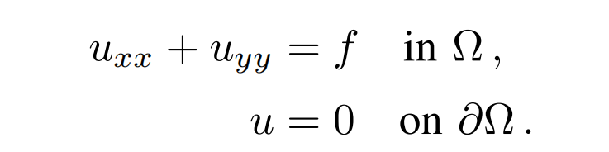
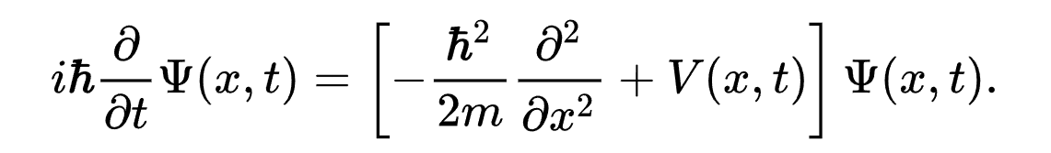
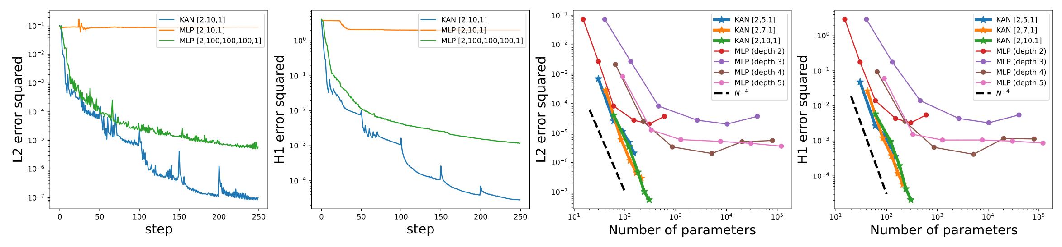
Kolmogorov–Arnold Networks作者回应
Q5：仅使用KAN求解了Possion Equation，需要求解更高维更复杂的PDE（比如Schrödinger equation）？
Answer：有待改进。

Slide 7
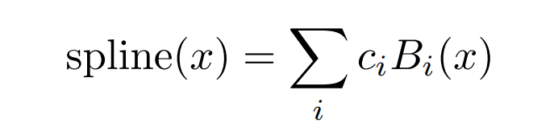
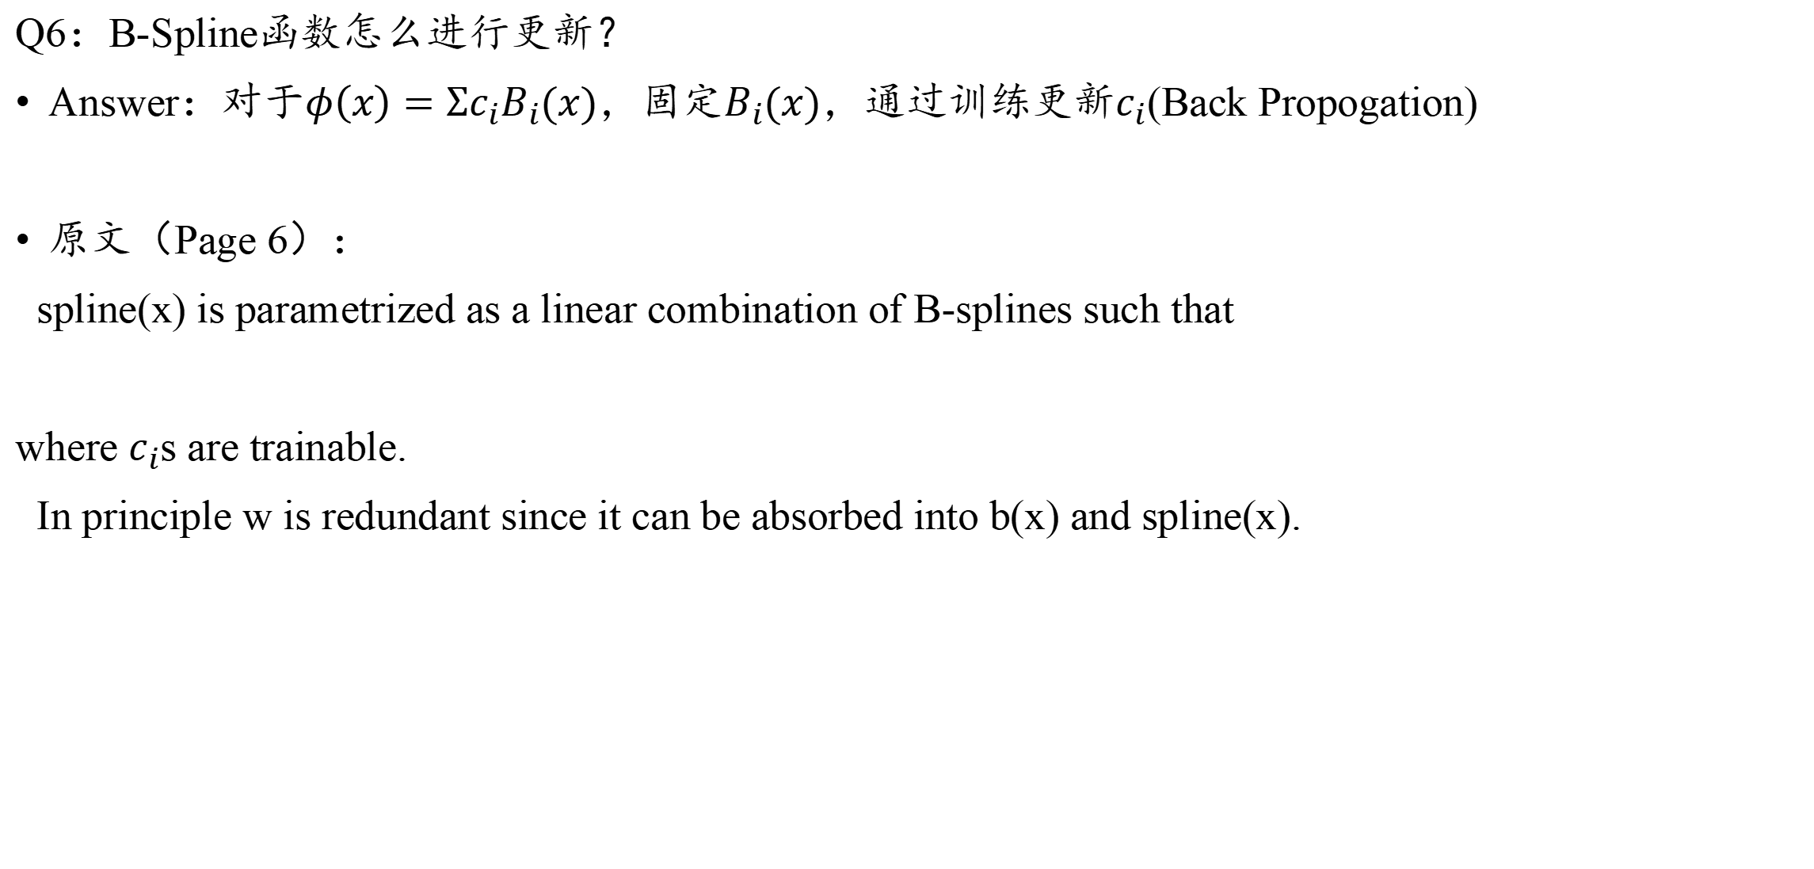
Kolmogorov–Arnold Networks作者回应
Q6：B-Spline函数怎么进行更新？
Answer：对于$φ\left(x\right)=Σc_{i}B_{i}(x)$，固定$B_{i}(x)$，通过训练更新$c_{i}$(Back Propogation)
原文（Page 6）：
spline(x) is parametrized as a linear combination of B-splines such that
where $c_{i}$s are trainable.
In principle w is redundant since it can be absorbed into b(x) and spline(x).

Slide 8
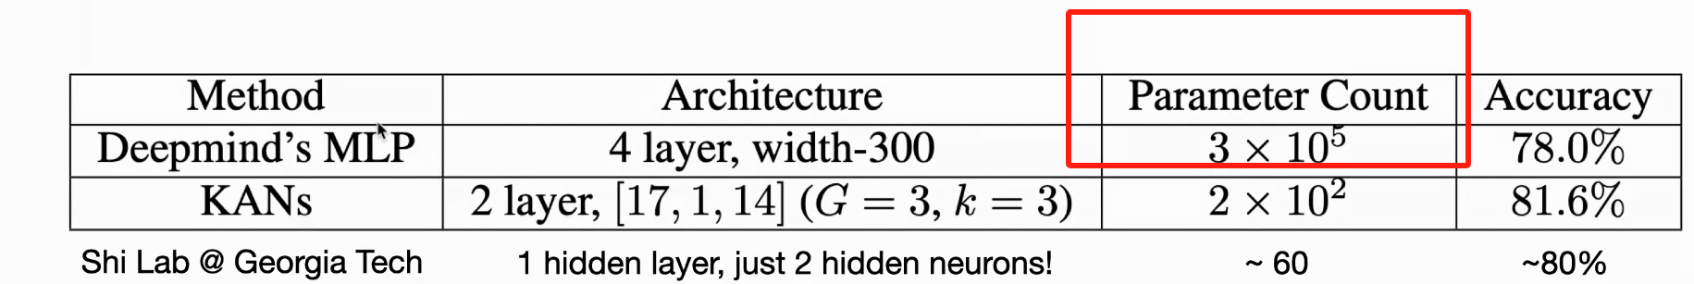
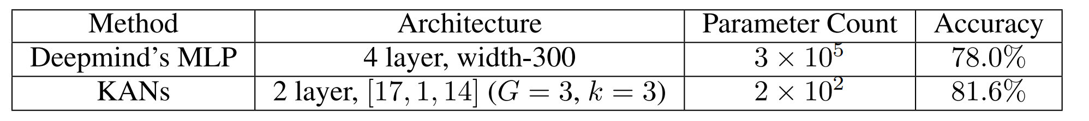
Kolmogorov–Arnold Networks作者回应
Q7：在Knot theory数据集上的预测结果遭到了Shi Lab 的质疑，认为故意破坏benchmark？
Answer：Good news!
原论文：
Shi Lab对MLP做实验时，使用了一层hidden layer与两个hidden neurons，参数量60，准确率80%！
认为KAN故意破坏了作为benchmark模型的MLP！

Slide 9
Kolmogorov–Arnold Networks作者回应
Q8：为什么认为KAN在AI 4 Science领域比MLP更有前景？
Answer： Symbolic formulas have better inductive biases aligned with KANs compared to MLPs.
The boundary is still to be explored.
Let's do a thought experiment.
(1) For a task generated by a teacher KAN, student KAN will perform better than student MLPs
(2) For a task generated by a teacher MLP, student MLP will perform better than student KANs.
So the real question is (quite philosophical):What is the network that is used to “generate” science/vision/language/whatever tasks that you care about?This is all about inductive biases. A network performs well for a task if the inductive bias of the networkagrees with the inductive bias of the task.

Slide 10
Kolmogorov–Arnold Networks作者回应
Q9：What makes KAN a KAN?
Technical: what is it?
Learnable activations => Not new! Spline networks, kernel machines...
Activation functions on edges => Not New! (2-Layer) Kolmogorov network.
Deeper than 2 layer => Not New! Multi-layer perceptrons.
The combination of all three properties is new.
KANs have learnable activation functions on edges, which can be made deep.
Sociological: what is it used for?
Paul Werbos (1974): A multi-layer perceptron can do XOR. The applicationwas for politics and sociology.
We (2024): A multi-layer Kolmogorov network (KAN) can be more accurateand interpretable than MLPs. The applications are for science.

Slide 11
Github Repos
KAN original implementation: stil good for interpretability, but efficiency sucks!
Efficient implementation: EfficientKAN/FastKAN/ChebyKAN
GraphKAN: KAN for Graph
KANRL: KAN for Reinforcement Learning
Different activation functions: FCNKAN, FourierKAN, JacobiKAN. ChebyKAN
KAN for LLM: KAN-GPT, Kansformer, KAN-SSM
KAN for time series
Convolution KAN
Physics-informed KAN
Different language/package: jax, julia, lua, keras, sklearn
KAN for diffusion
KAN for ODE

Slide 12
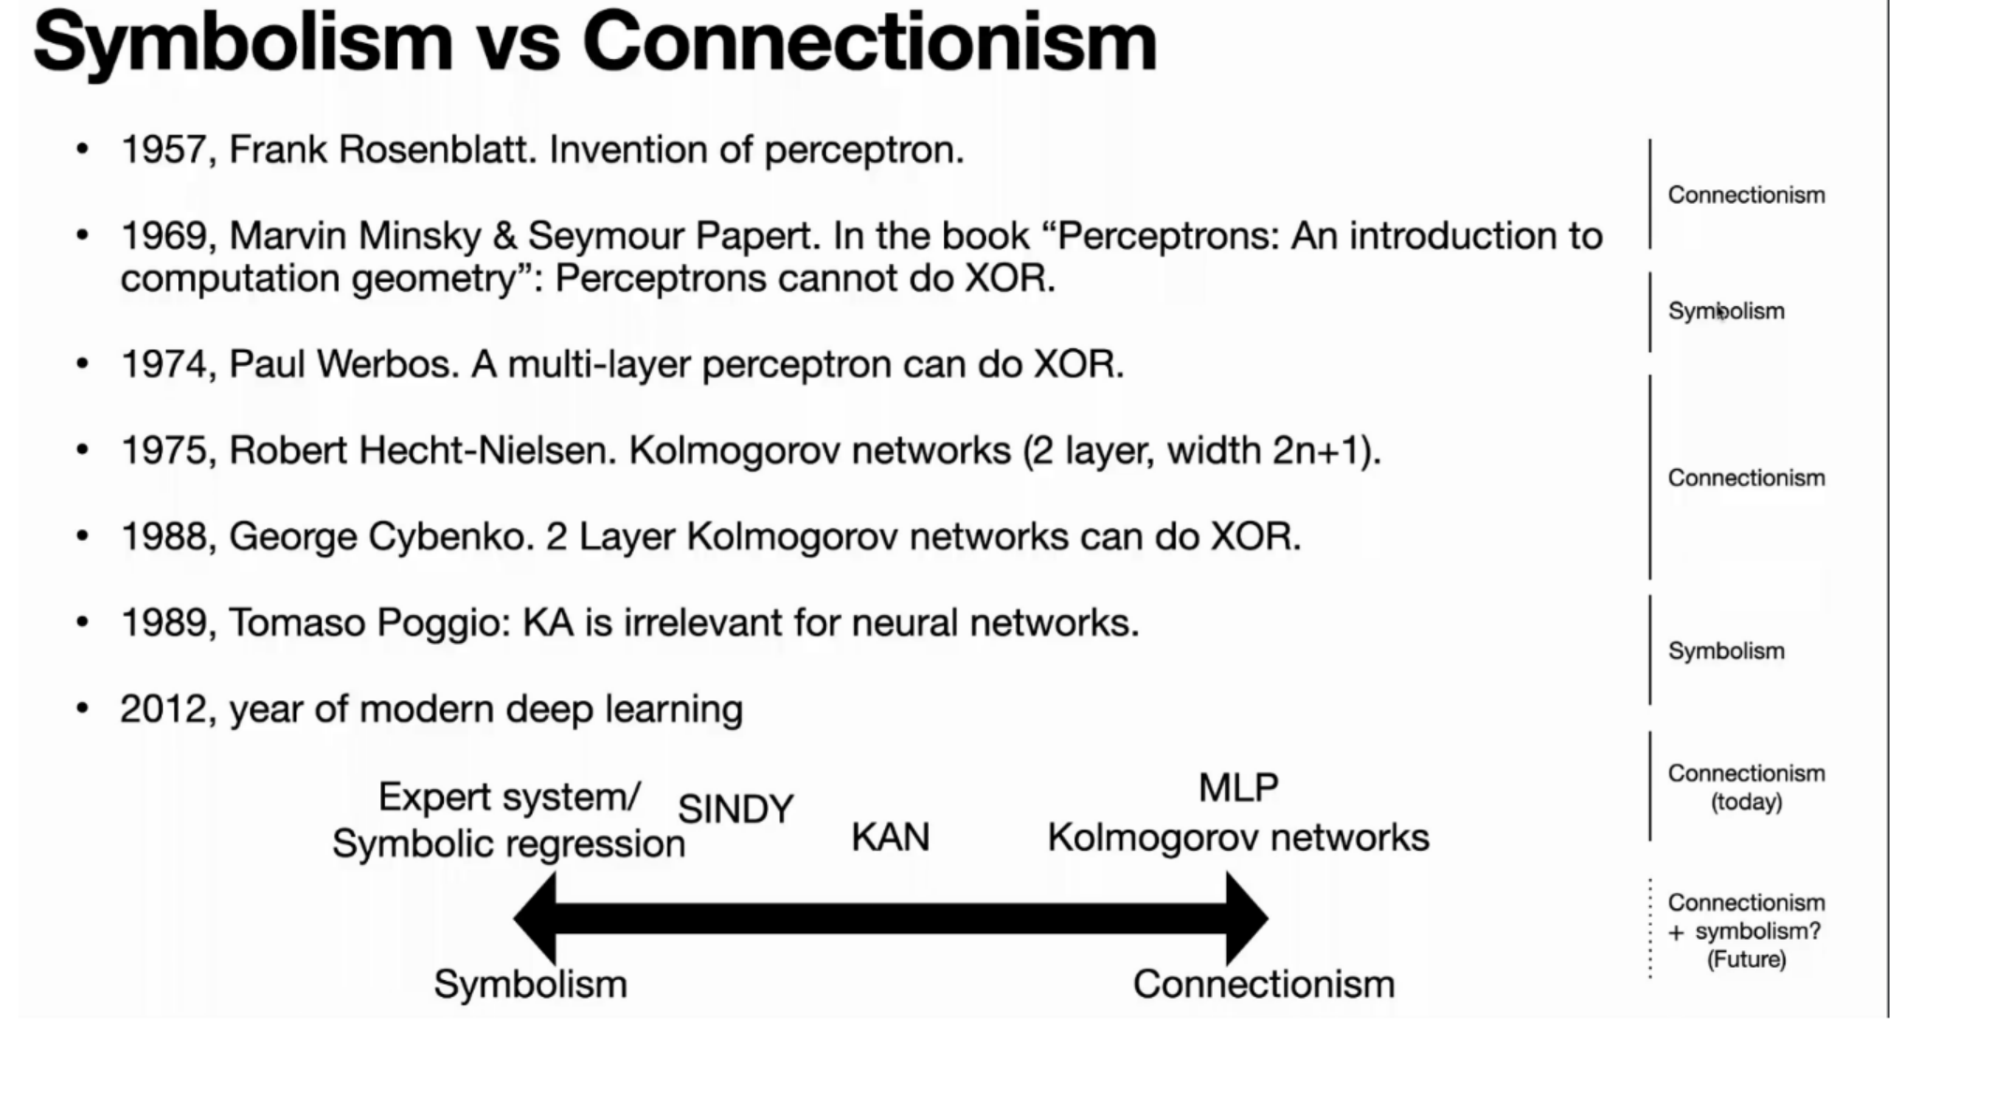
Symbolism vs Connectionism1957

Slide 13
Chapter 2 KAN vs PINN?
Solving partial differential equations

Slide 14
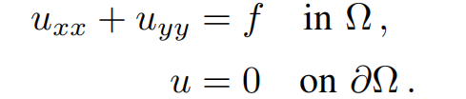
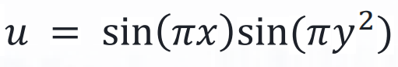
Solve Possion Equation By PINN
Poisson equation with zero Dirichlet boundary data:
Non-homogeneous:
Ture Solution:
Loss Function:
Loss function of main equation!
Loss function of boundary conditions!

Slide 15
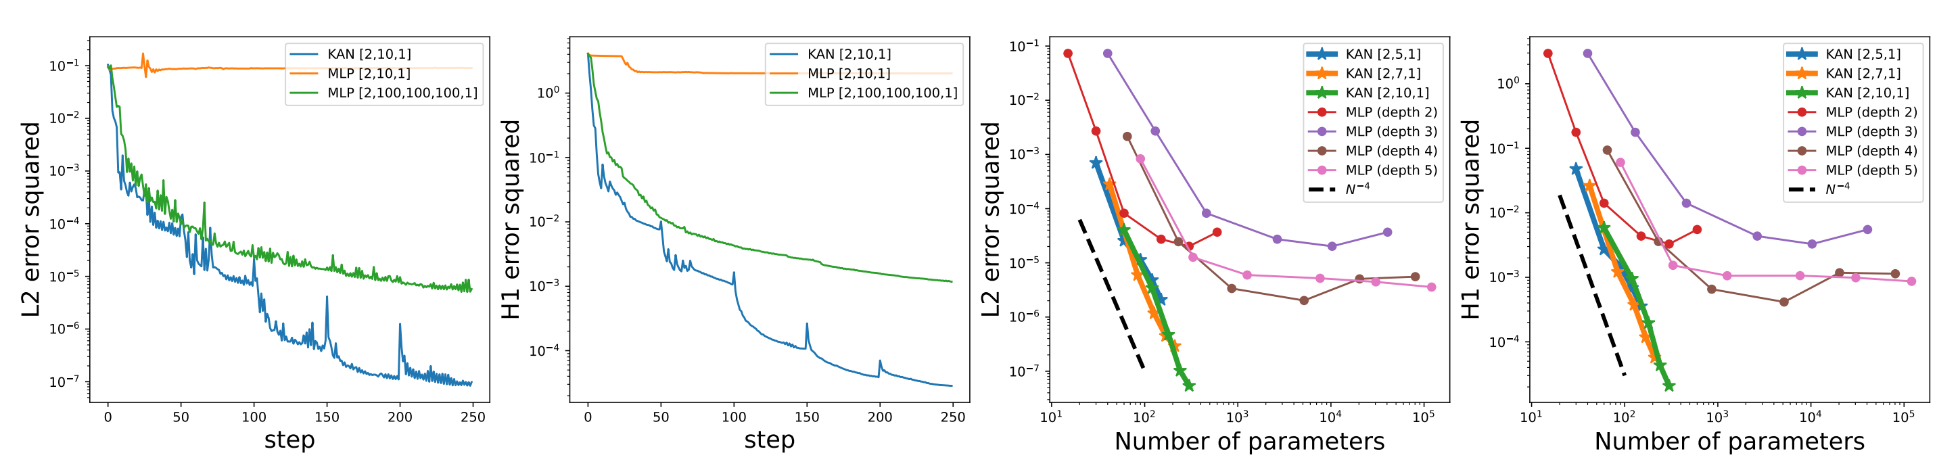
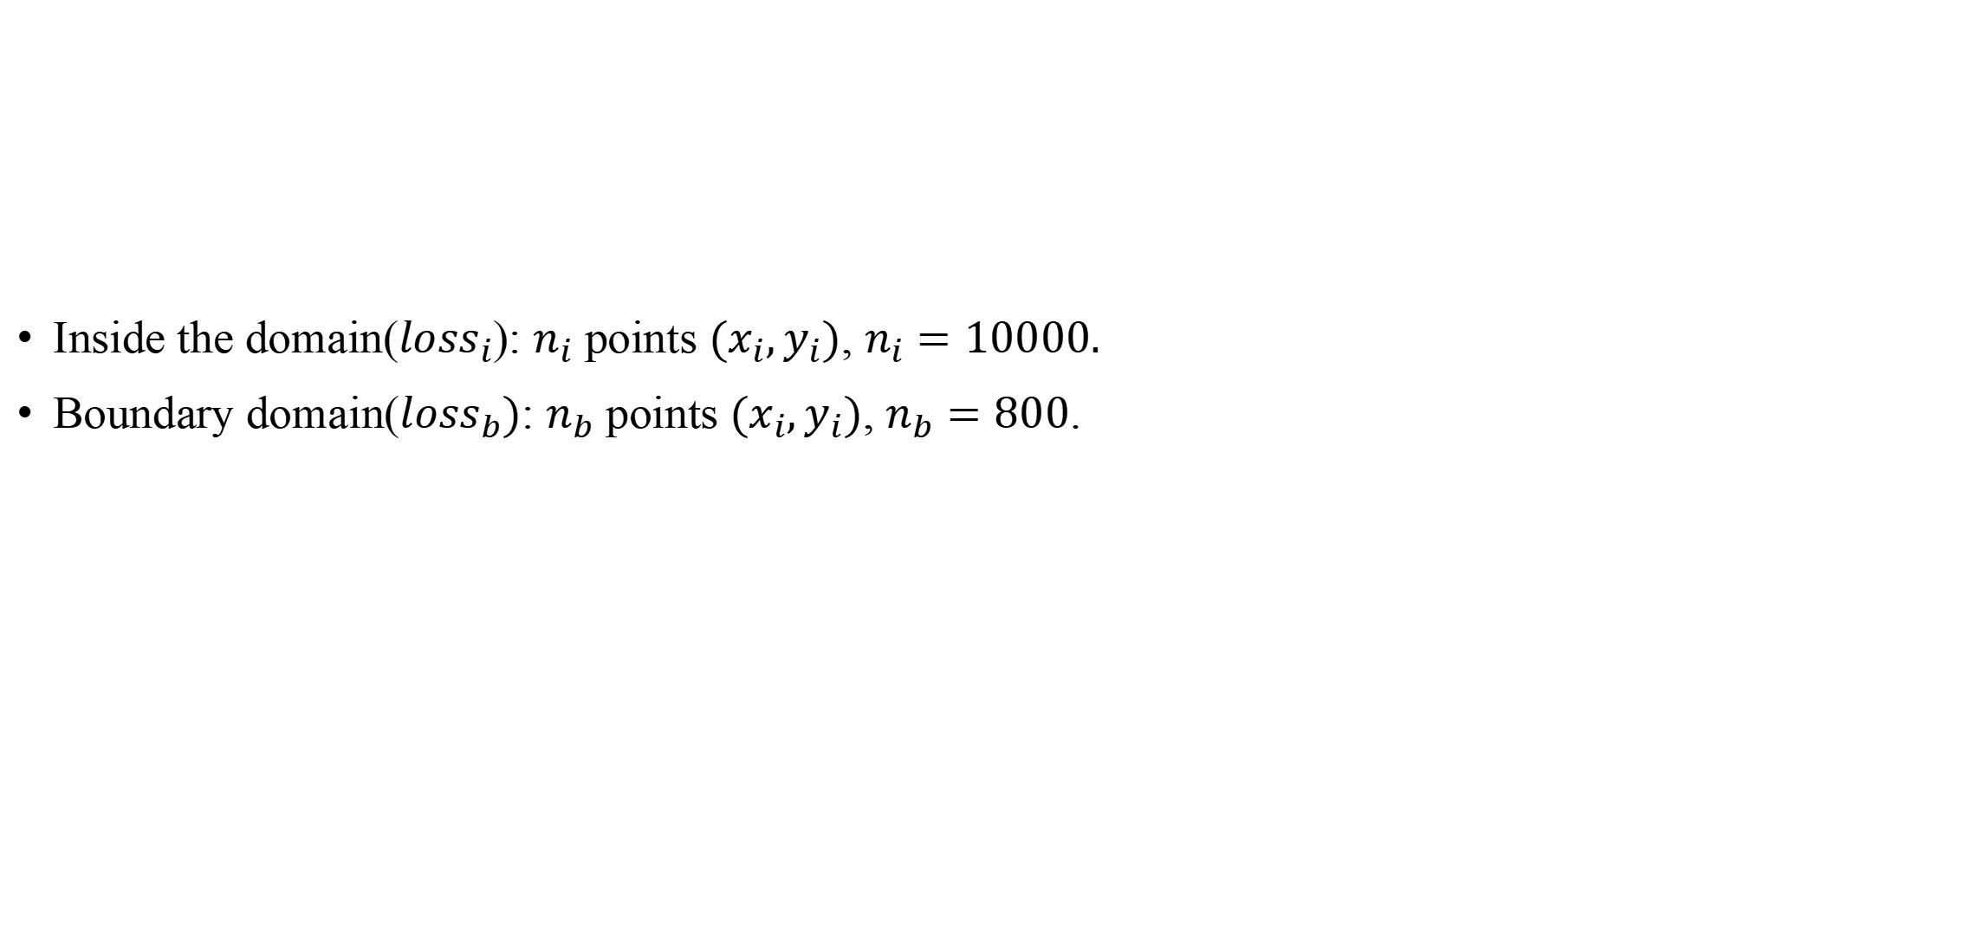
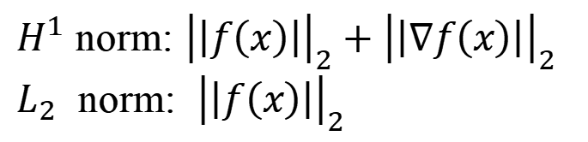
PINN vs KAN
Inside the domain($loss_{i}$): $n_{i}$ points $(x_{i},y_{i})$, $n_{i}=10000.$
Boundary domain($loss_{b})$: $n_{b}$ points $(x_{i},y_{i})$, $n_{b}=800$.
Loss function of main equation!
Loss function of boundary conditions!
$H^{1}$ norm: ${\left|\left|f\left(x\right)\right|\right|}_{2}+{\left|\left|∇f\left(x\right)\right|\right|}_{2}$
$L_{2}$ norm: ${\left|\left|f\left(x\right)\right|\right|}_{2}$

Slide 16
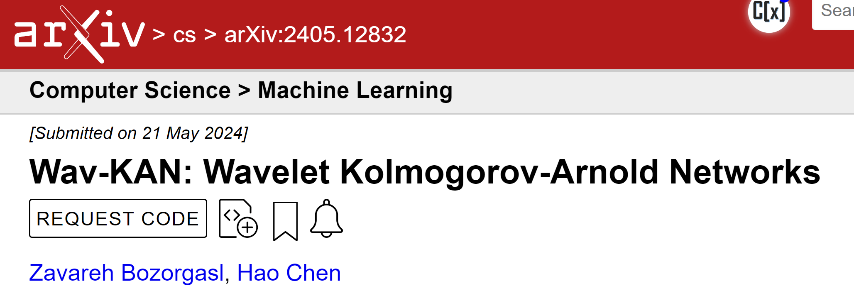
Chapter 3 Wav-KAN: Wavelet Kolmogorov-Arnold Networks

Slide 17
Research Background
Application of Wavelet:
Wavelet has been extensively employed in multiresolution analysis. There are some studies of wavelet in neural networks in Universal Approximation Therory (UAT). For example, the complex Gabor wavelet activation function is renowned for its optimal concentration in the space-frequency domain and its exceptional ability to represent images accurately.
Disadvantage of KAN:
High training cost
Core Idea:
uses wavelet in Kolmogorov-Arnold representation theorem for an arbitrary widths and depth neural networks.
Notes:
小波已广泛应用于多分辨率分析。小波变化在神经网络全局逼近理论领域有比较广泛的应用；并且由于其比较特殊的函数性质，可以学习数据波峰中的隐藏规律并且丢弃掉异常噪声。
复Gabor小波激活函数以其在空间频域的最佳浓度和精确表示图像的特殊能力而闻名。因此，[15]在应用中使用Gabor小波进行隐式神经表示（INR）。

Slide 18
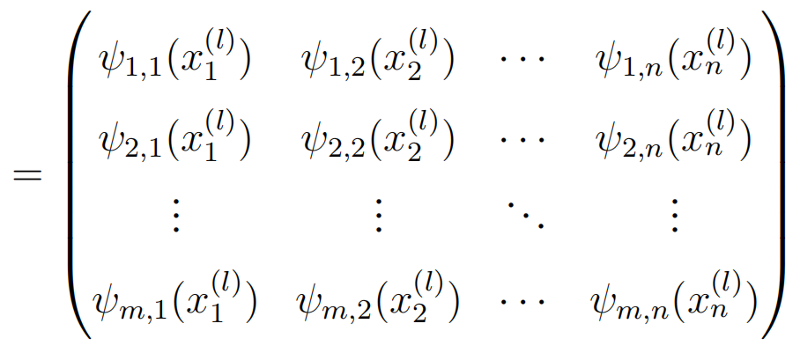
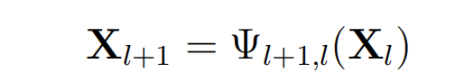
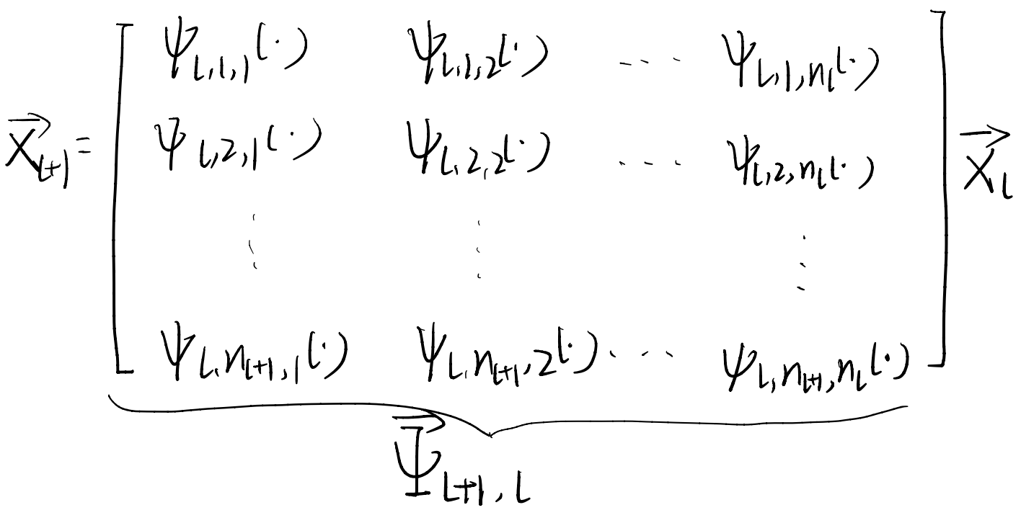
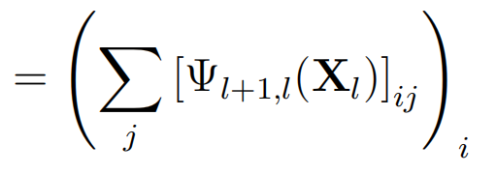
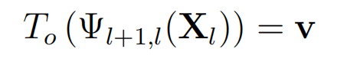
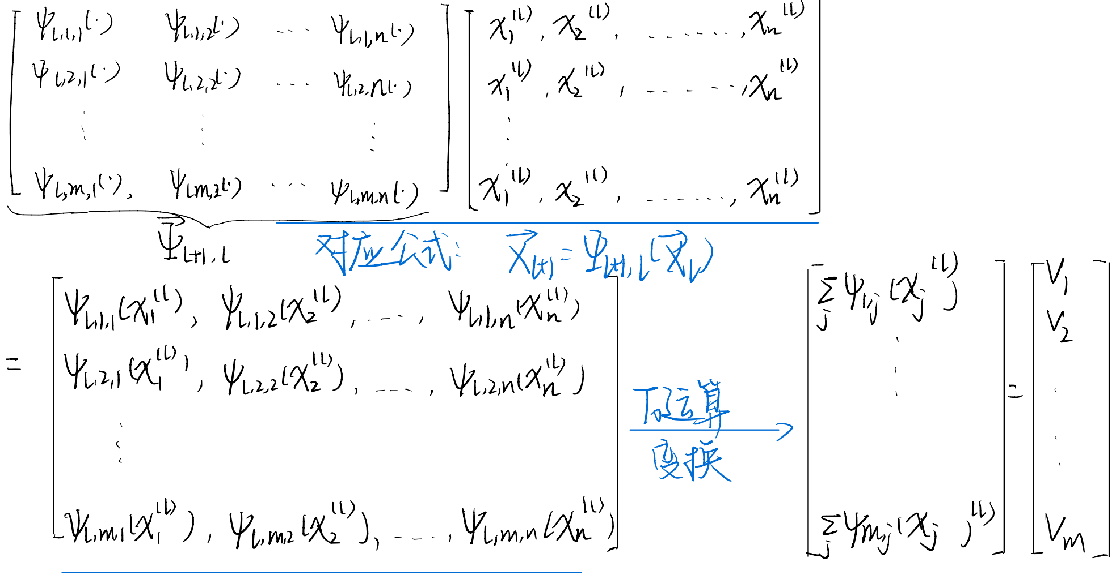
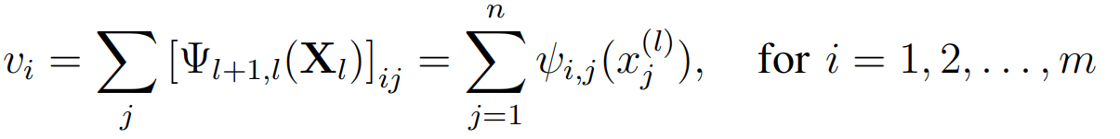
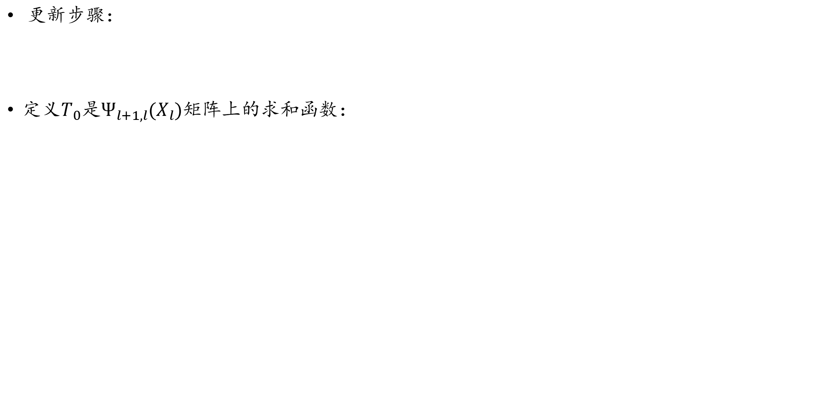
Research Framework
更新步骤：
定义$T_{0}$是$Ψ_{l+1,l}(X_{l})$矩阵上的求和函数：

Slide 19
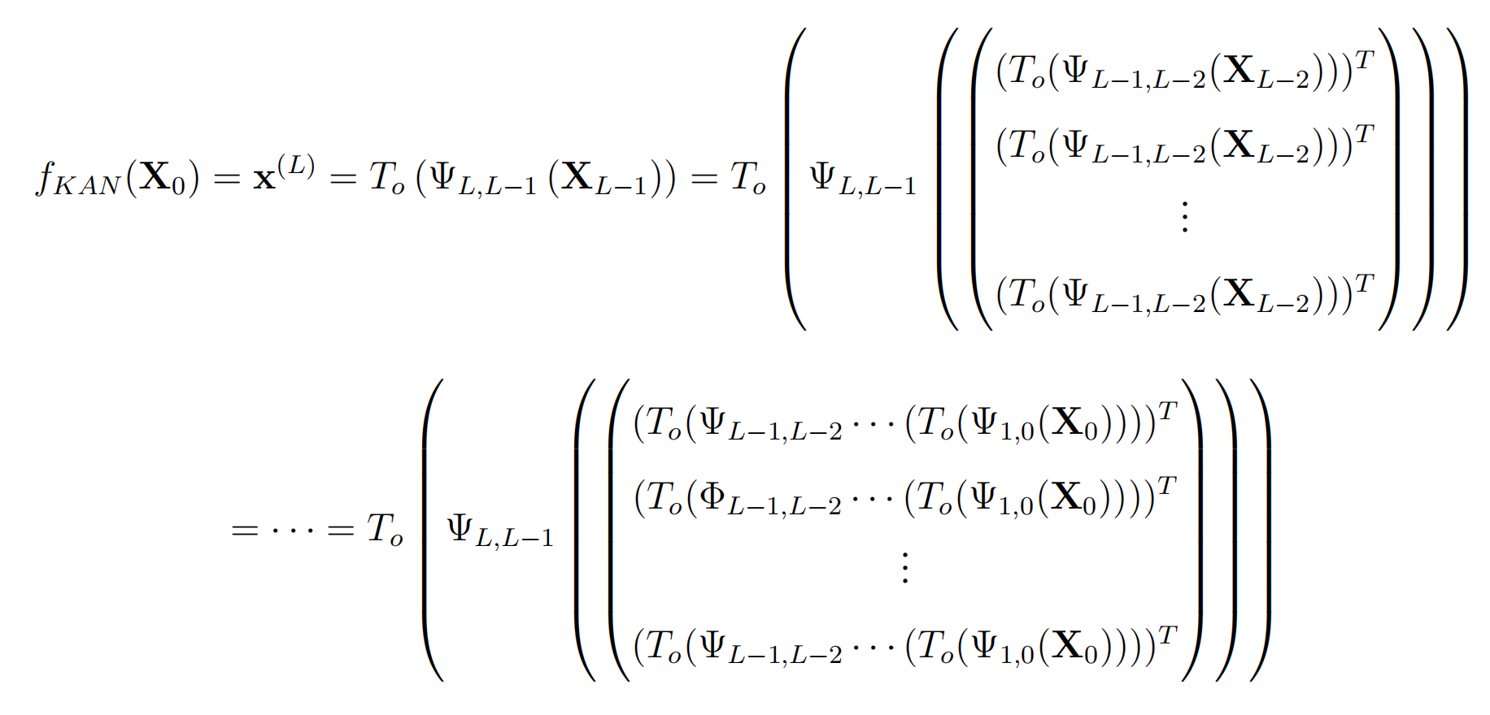
Research Framework
与KAN网络的对比：

Slide 20
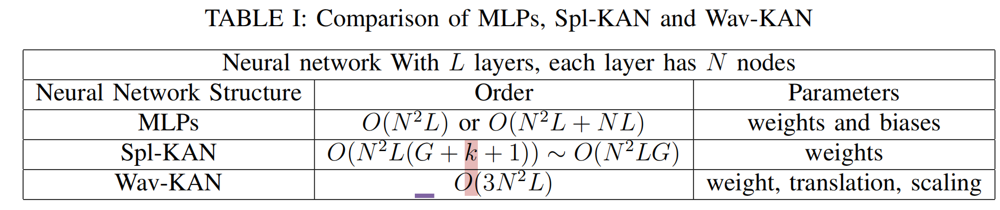
Advantages of Wavelets Function
Wavelets excel in multi-resolution analysis enabling different levels of detail to be represented simultaneously.
Wavelets offer sparse representations, which can lead to more efficient neural network architectures and faster training times.
Wavelets excel by maintaining a delicate balance between accurately representing the underlying data structure and avoiding overfitting to the noise.
Wav-KAN has solved the major disadvantage of Spl-KANs which was slow training speed.
Notes:
小波在多分辨率分析，使不同层次的细节同时表示。这种功能对神经网络中的特征提取非常有利，因为它能够捕获高频细节和低频趋势。
小波提供了稀疏表示，这可以导致更有效的神经网络架构和更快的训练时间。它们也非常适合处理非平稳信号和局部特征，使它们成为图像识别和信号分类等理想应用。比如说，通过将数据分解成不同的频率分量，小波可以在剔除无关噪声的同时，分离和保留显著的噪声模式。事实上，这源于小波捕获低频和高频函数的能力。

Slide 21
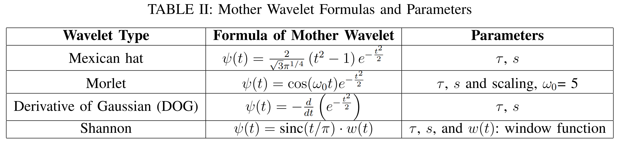
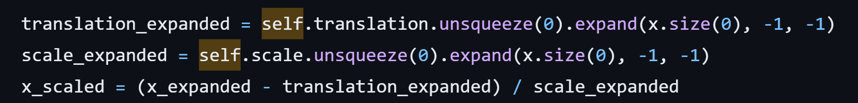
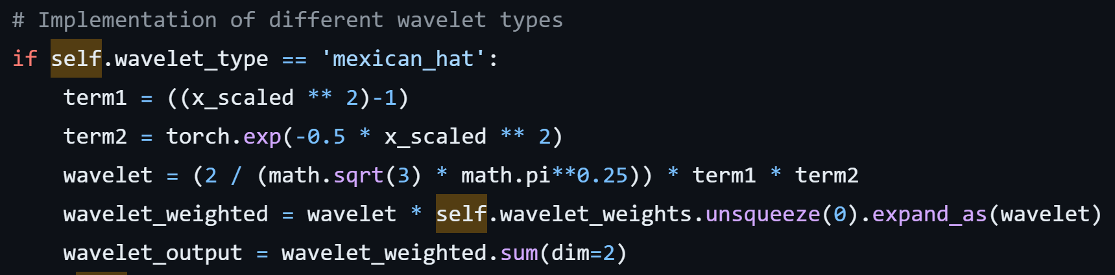
Selection of Wavelets Function
https://github.com/zavareh1/Wav-KAN/blob/main/KAN.py#L28

Slide 22
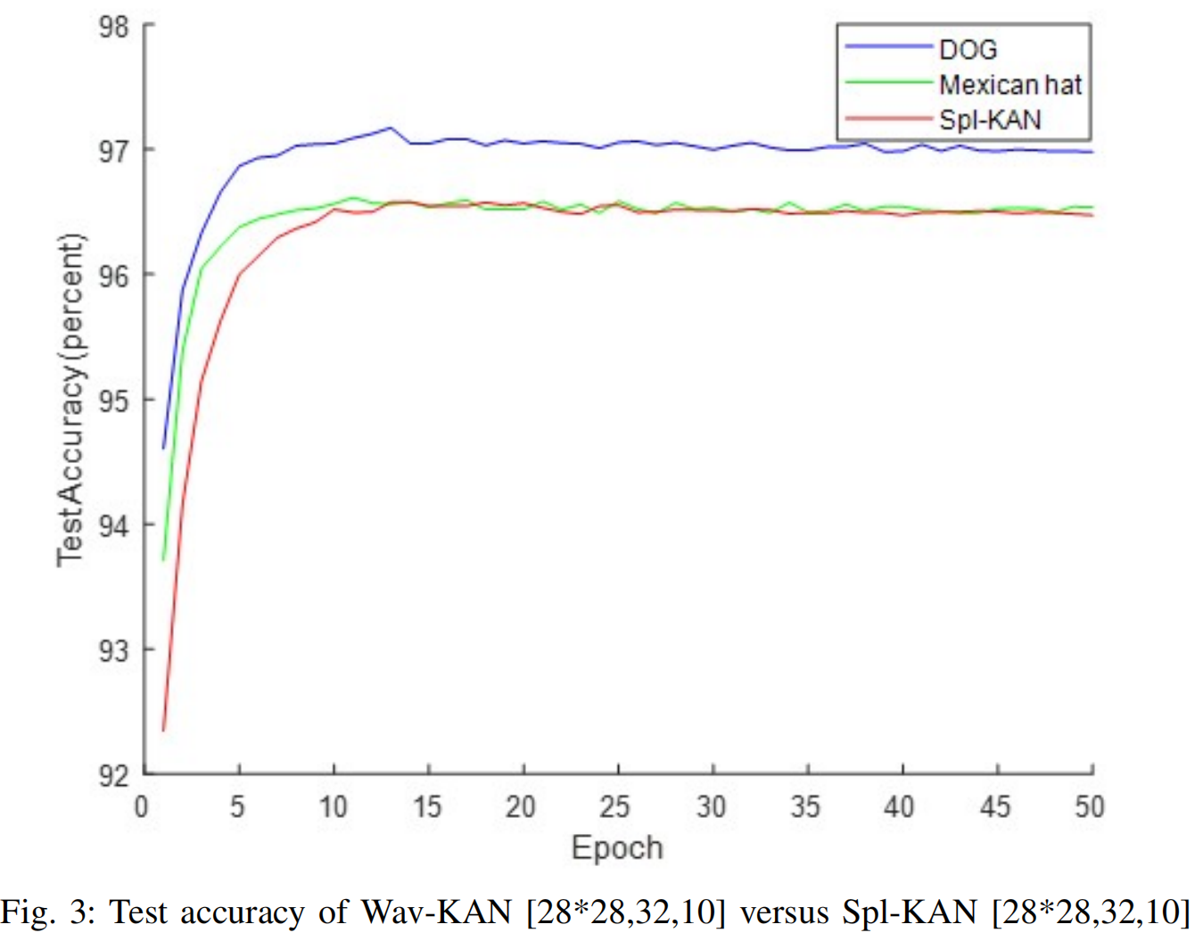
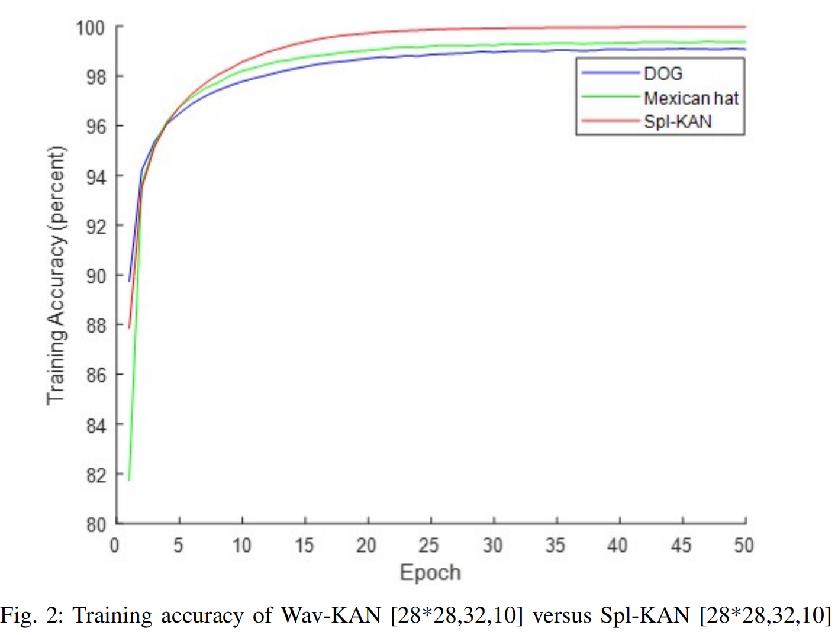
Evaluation of Wav-KAN over Spline-KAN(original)
The choice of wavelet significantly impacts the performance of the KAN model!
Overfitting!
The importance of wavelet selection!

Slide 23
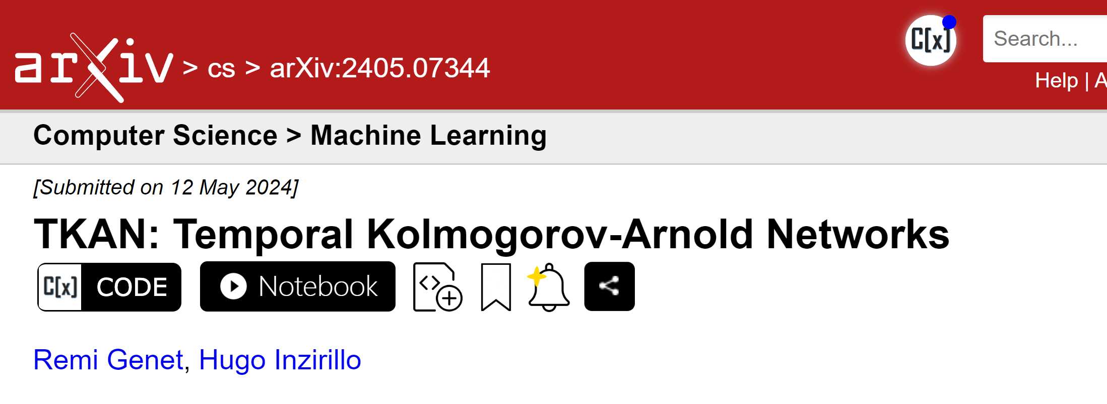
Chapter 4 TKAN: Temporal Kolmogorov-Arnold Networks

Slide 24
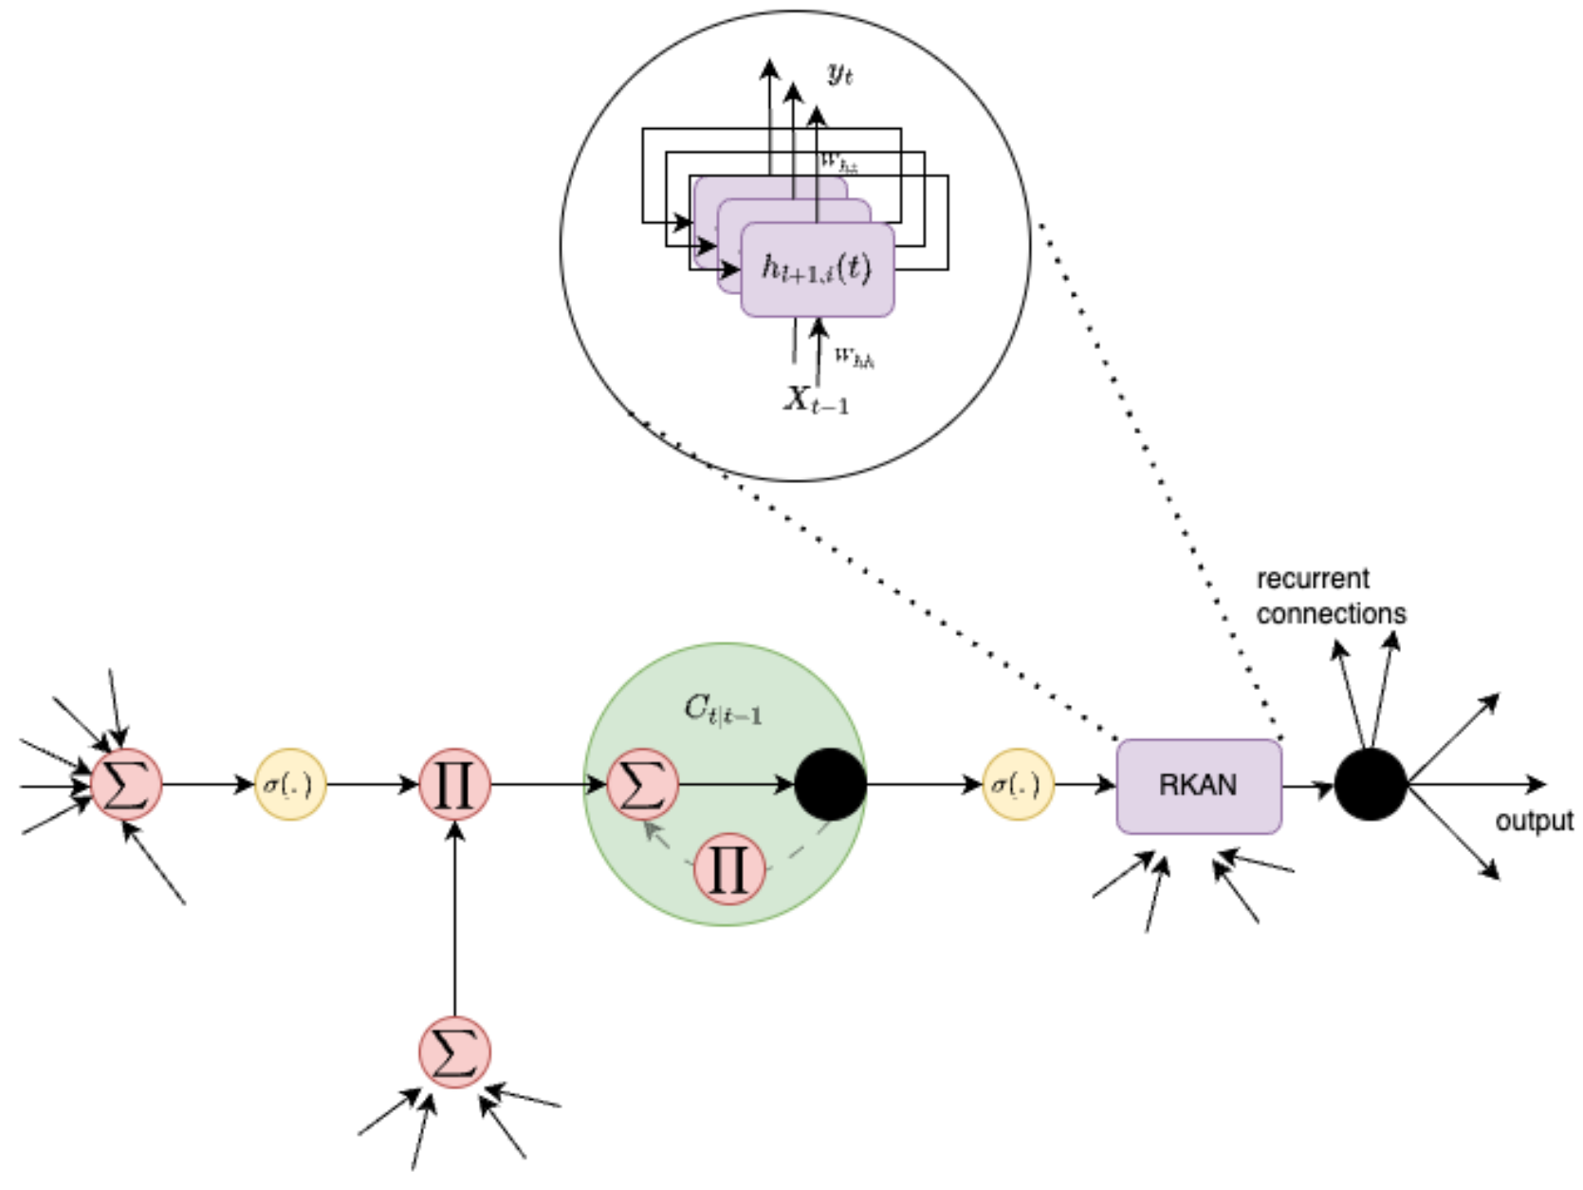
Research Background
Recurrent Neural Networks (RNNs) have revolutionized many areas of machine learning, particularly in natural language and data sequence processing.
Long Short-Term Memory (LSTM) has demonstrated its ability to capture long-term dependencies in sequential data.
Idea: Combination of RNN & LSTM & KAN!
TKAN=RKAN(RNN+KAN)+LSTM(Gate)

Slide 25
Research Background
TKAN=RKAN(RNN+KAN)+LSTM(Gate)
RKAN Layers: RKAN layers enable the retention of short term memory from previous states within the network. Each RKAN layer manages this short term memory throughout the processing in each layer.
Gating Mechanism: these mechanisms help to manage the information flow. The model decides which information should be retained or forgotten over time.

Slide 26
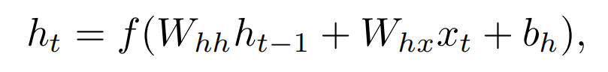
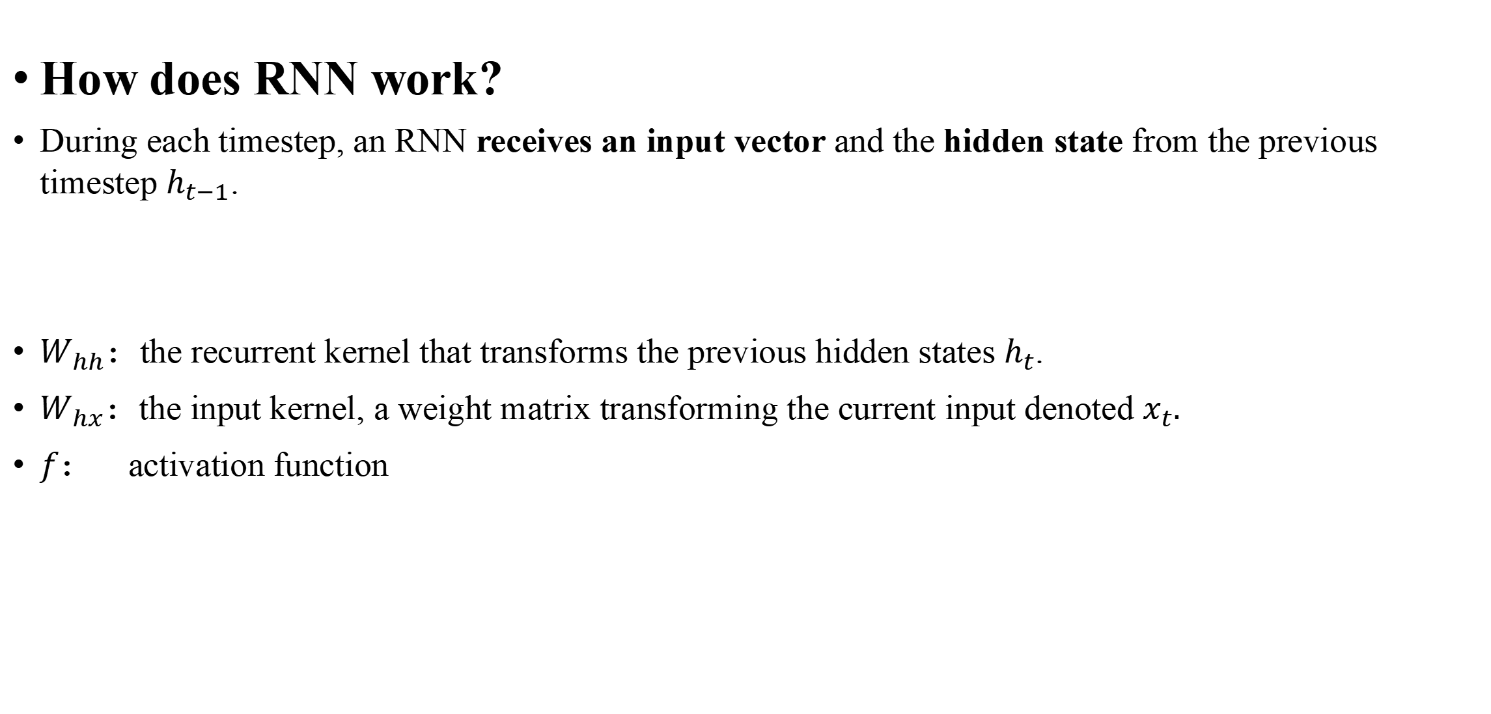
1st Part of TKAN - Recurring Kolmogorov-Arnold Networks
How does RNN work?
During each timestep, an RNN receives an input vector and the hidden state from the previous timestep $h_{t−1}$.
$W_{hh}$：the recurrent kernel that transforms the previous hidden states $h_{t}$.
$W_{hx}$：the input kernel, a weight matrix transforming the current input denoted $x_{t}.$
$f$： activation function
Hidden state
Current input
Notes:
在每个时间步长中，一个RNN接收到来自前一个时间步长和−1的输入向量和隐藏状态。
递归核是一个权重矩阵，它可以转换之前的隐藏状态。
输入核，一个权重矩阵转换当前输入分别表示xt。

Slide 27
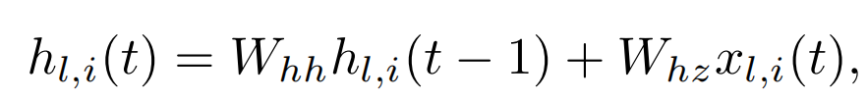
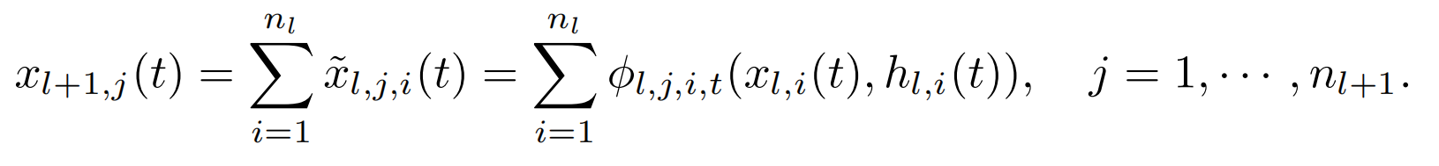
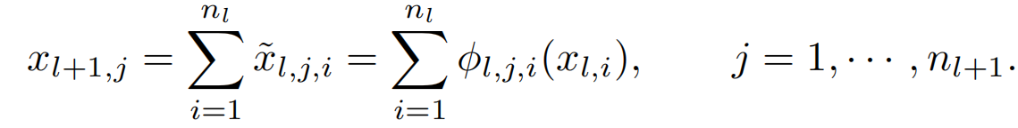
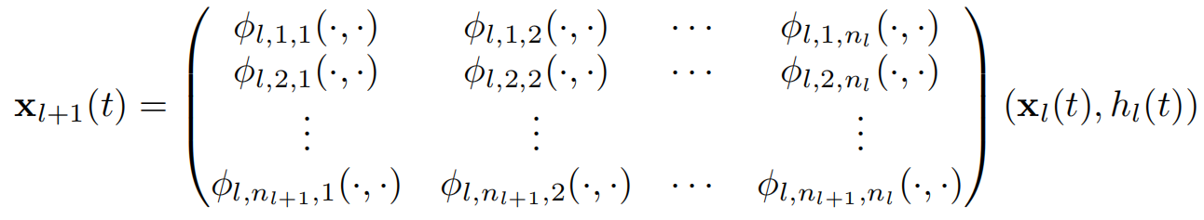
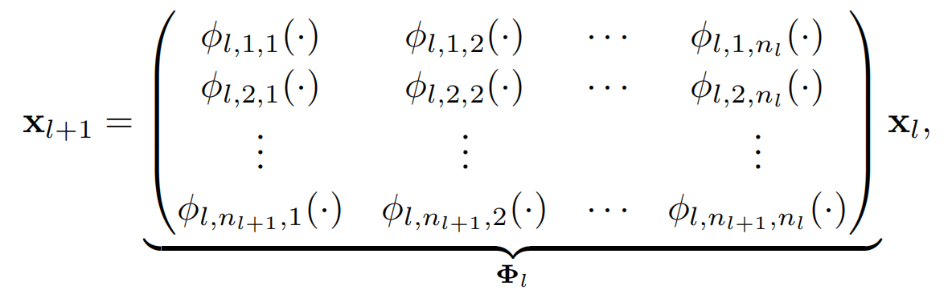
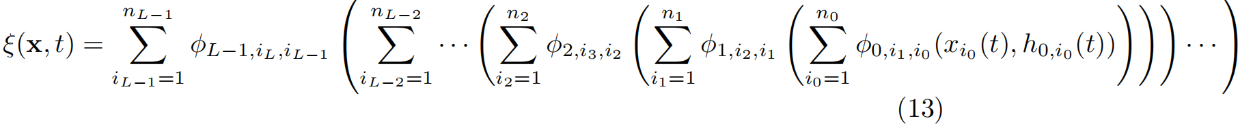
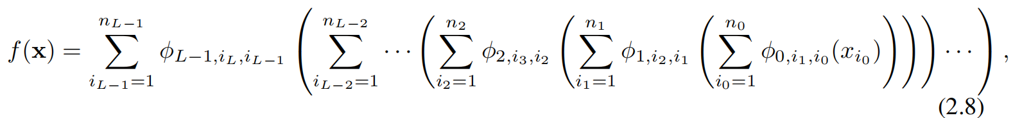

1st Part of TKAN - Recurring Kolmogorov-Arnold Networks
Let us denote $h_{l,i}(t)$ a memory function capturing the history of node $i$ in $l$-th layer;
Let us denote $h_{l,i}(t)$ a memory function capturing the history of node $i$ in $l$-th layer;
Notes:
我们在这里引入了内存存储单元h，由一个输入核和递归核组成，看一看h的计算公式，其中x的更新方式我们引入了KAN网络，值得注意的是由于RKAN是处理长时间序列的，所以你的数据维度要额外增加一个时间单元步长t。为了引入时间依赖性，我们将每个变换函数ϕl，j，i修改为时间相关性，把单样条插值函数改成了双变量样条插值函数，比如\phi变成了双变量。
循环内核是RKAN层从上下文和数据顺序很重要的序列中学习的关键。
我们在更新完x以后，关于递归KAN层，网络现在在每一层嵌入内存管理。

Slide 28










2nd Part of TKAN – Gating Mechanism
Forget Gate:
Input Gate:
Output Gate:
Update cell state:
Update hidden state:
Predicted output:
Notes:
为了保持记忆，我们从LSTM [HS97；SM19]中获得了灵感。我们表示维数d的输入向量，用xt表示。这个单元使用几个内部向量和门来管理信息流。
遗忘门，决定了我们要从之前的状态中丢弃哪些信息。
输入门，决定了控制包含哪些新信息。
输出门，决定了给定ξ（x，t）的当前状态的信息

Slide 29



Evaluation of TKAN
其中$R^{2}$分数通常随着预测范围的增加而下降。这种趋势在时间序列预测中是典型的，因为做出准确的长期预测越来越困难。
Short-term Prediction: GRU
Mid-term Prediction: LSTM
Long-term Prediction: TKAN!
质疑：为什么不和Transformer在长时间序列的预测表现进行对比？以及Informer模型？使用的benchmark太古早了。

